Slide 1


PowerCore BMS: Advanced Safety and Monitoring Solution
PRESENTATION ON
BY,
Siddhesh Dangade

Slide 2
OUTLINES
Problem Statement
Project Objective
Software Analysis & Troubleshooting
Block diagram
Core Component utilized
Circuit Diagram
3s BMS & 3S 18650 Battery Pack
SOC & SOH Monitoring using INA219
Prototype model

Slide 3
Problem Statement
Traditional BMS solutions, limited to voltage and current monitoring, cannot detect early signs of thermal runaway, hot spots, or harmful gas emissions—leading to safety risks, reduced battery life, and costly failures.

Slide 4
Project Objective:
This system prioritises enhanced safety mechanisms and real-time monitoring capabilities. The focus is on proactive protection against potential hazards and providing accurate operational data.
Proactive hazard prevention
Accurate operational data
Optimised battery lifespan
Optimised saftey system

Slide 5
Software Analysis & Troubleshooting
Tools Used → Wokwi (simulation)
Steps → Simulated circuits → Found errors → Debugging → Re-tested in Wokwi
Outcome → Faster debugging, safer hardware testing, improved accuracy
During development we made 70+ software revisions — each iteration reduced faults, improved stability in simulation, and increased confidence before hardware testing.

Slide 6
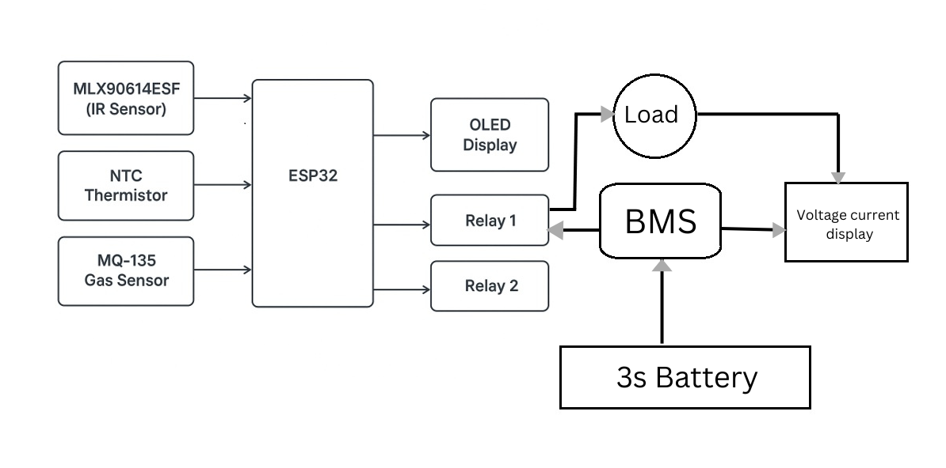
Block diagram :

Slide 7
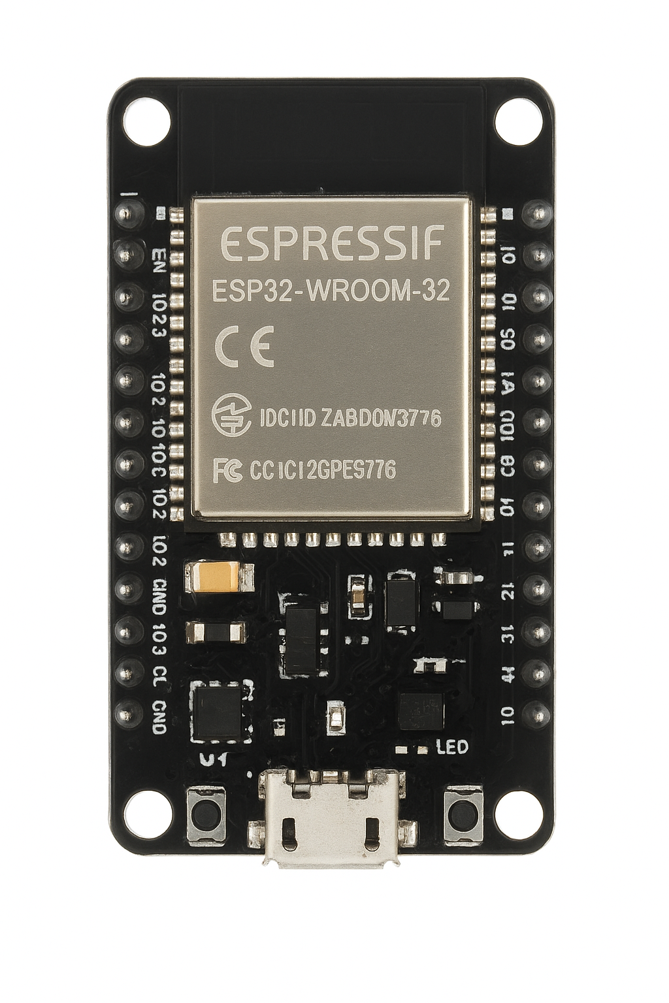
CORE COMPONENT UTILISED
ESP-32
The ESP32 collects data from voltage, current, temperature (NTC & IR), and MQ-135 gas sensors. It processes this information to detect overheating, thermal runaway, or harmful gas emissions and triggers alerts. It also enables wireless monitoring for real-time safety and diagnostics.

Slide 8
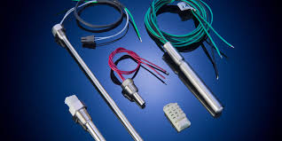
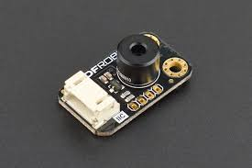
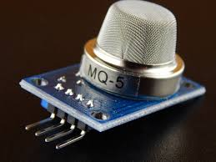
NTC Thermistor
Infrared Sensor
MQ-135 gas sensor
The NTC thermistor monitors battery temperature for early overheating detection and sends data to the ESP32.
The MLX90614ESF infrared sensor measures temperature without contact and detects hot spots early. It communicates via I²C to provide real-time monitoring and safety alerts.
The MQ-135 gas sensor detects harmful gases like smoke and NH₃ and sends data to the ESP32, which triggers alerts to prevent hazards.

Slide 9
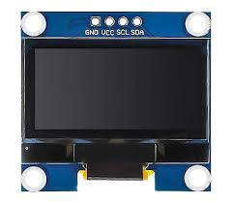
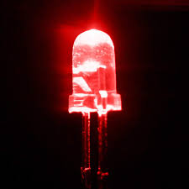
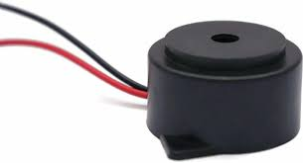
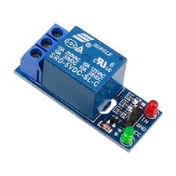
OLED Display
LED
Buzzer
Relay

Slide 10
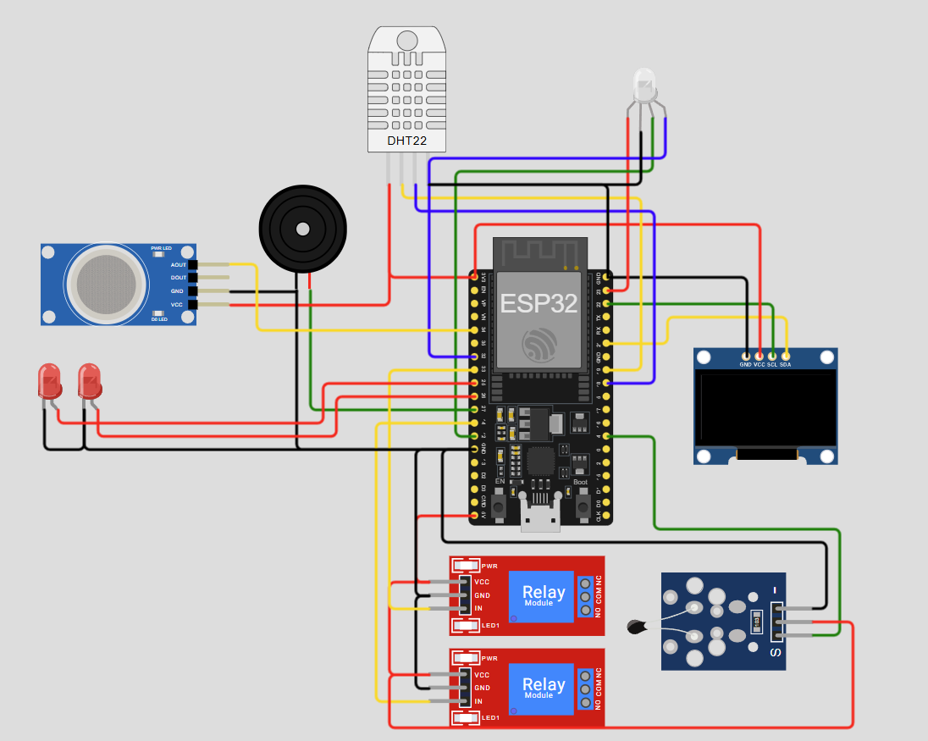
Circuit Diagram

Slide 11
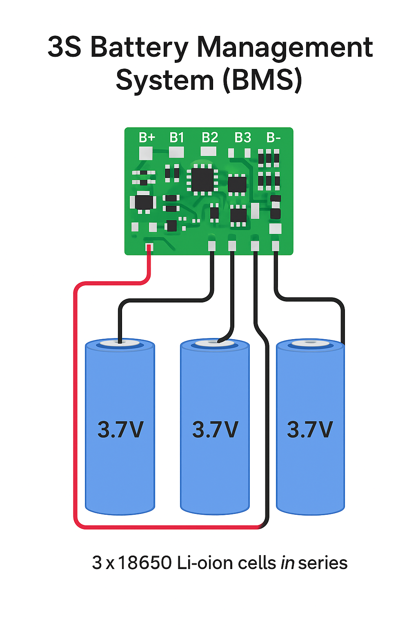
3S BMS
Overcharge & over-discharge protection
Balances cell voltages for uniform performance
Safeguards against short-circuit & overcurrent

Slide 12
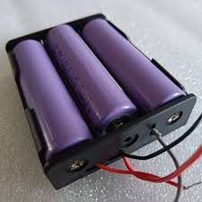
3S 18650 Battery Pack
3 × 18650 Li-ion cells in series (3S)
Nominal voltage: 11.1 V (3 × 3.7 V)
Full charge voltage: 12.6 V (3 × 4.2 V)
Capacity: same as single cell 2200mAH

Slide 13
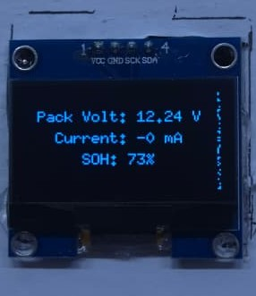
SOH & SOC Monitoring using INA219
State of Health (SOH)
Reflects battery aging and performance degradation over time.
Capacity Fade Method
SOH = (Measured Capacity ÷ Rated Capacity) × 100%. Directly indicates capacity loss.

Slide 14
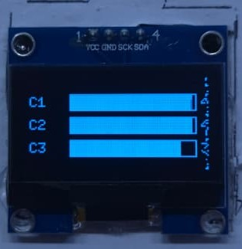
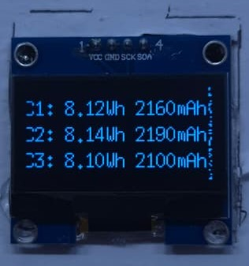
State of Charge (SOC)
Represents the remaining battery capacity, indicating how much energy is left.
SOC = (Remaining Capacity ÷ Nominal Capacity) × 100%

Slide 15
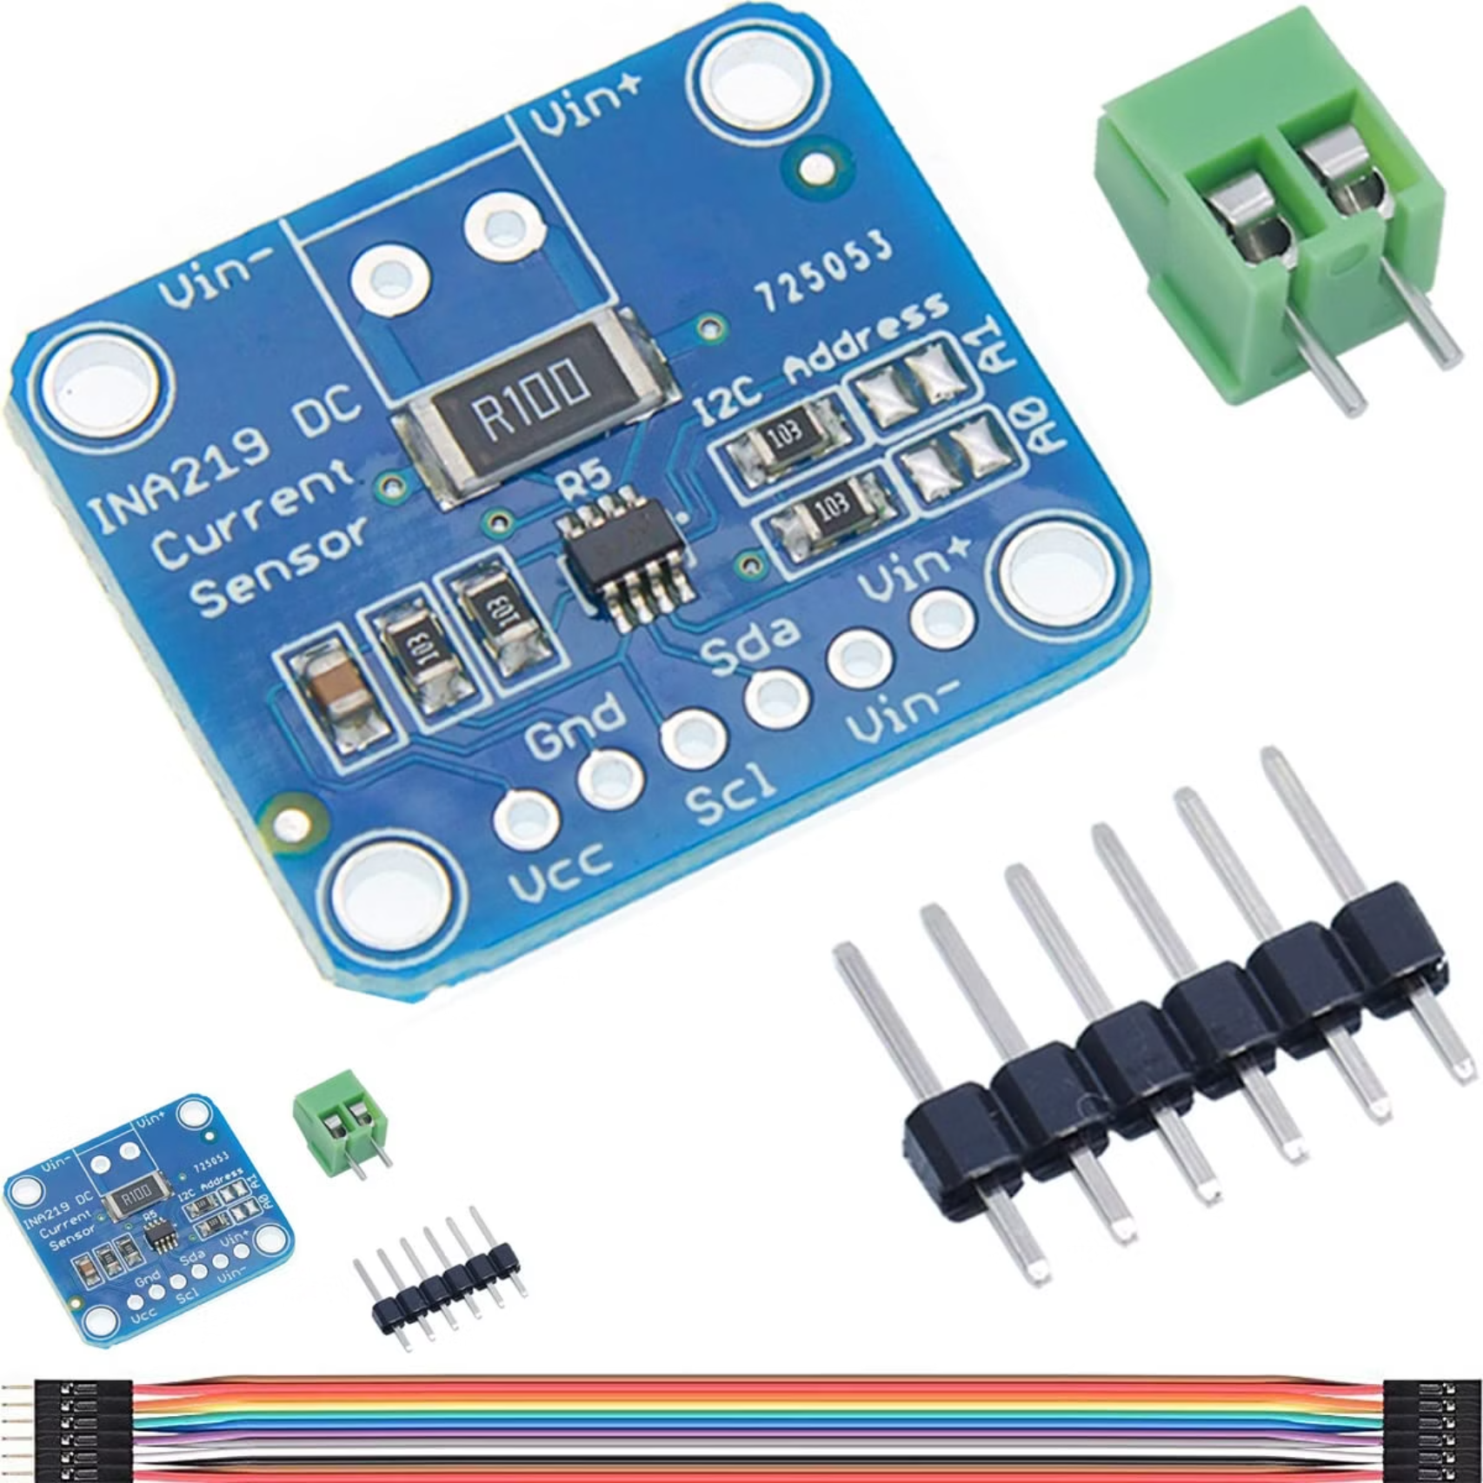
Precision Current Sensor INA219
High-side current sensor with I²C interface
Measures Bus Voltage, Shunt Voltage, Current, and Power.
Voltage range: up to 26V.
Current measurement depends on the shunt resistor used.
Integrated Analog-to-Digital Converter (ADC) with averaging for accuracy.

Slide 16
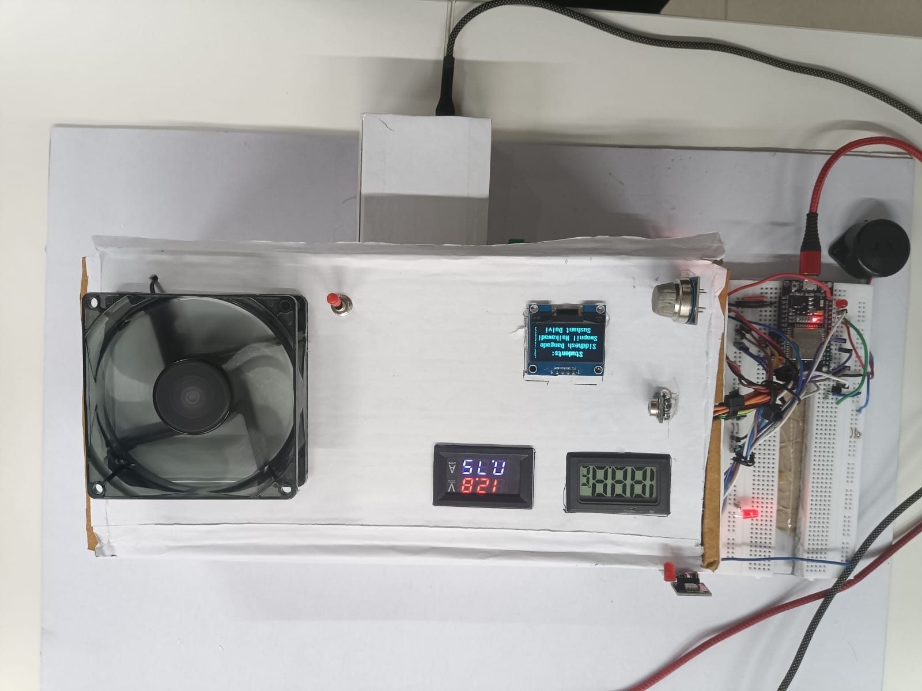
Prototype model

Slide 17
THANK YOU

